Slide 1
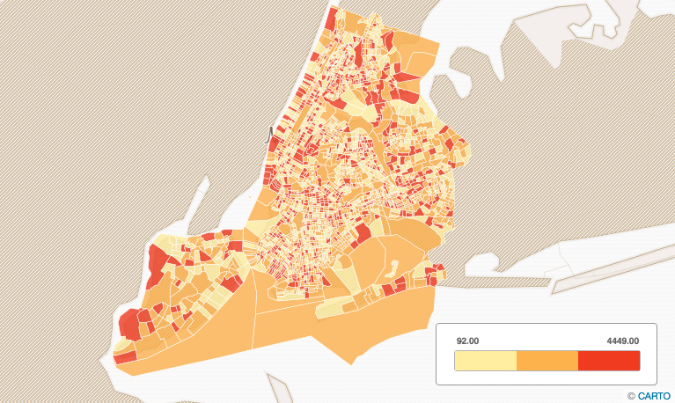
Unlock hidden real estate value through the lens of short term renters
October 28, 2016
Presentation by Ed Chin

Slide 2
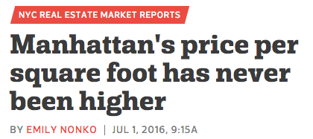
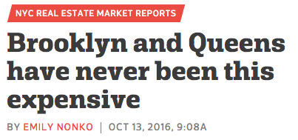
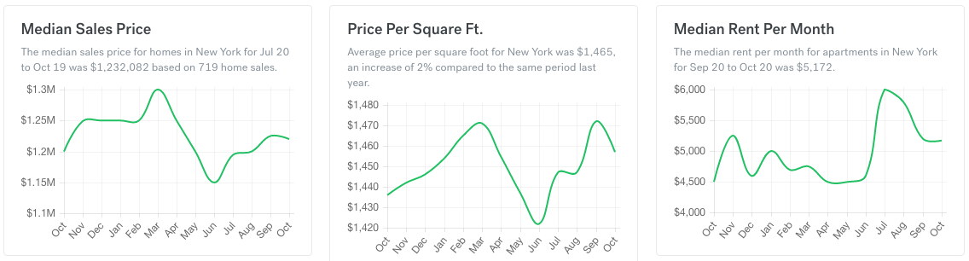

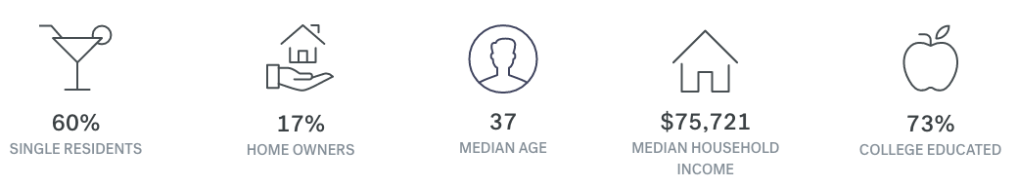
New York City Real Estate Overview

Slide 3

Is NYC Real Estate Too Expensive?
Where can a buyer find value?

Slide 4

The Airbnb Effect
Founded in 2008, Airbnb is a peer-to-peer online marketplace that connects homeowners to short-term renters
The short-term rental platform is providing an alternative revenue stream to homeowners that was not previously accessible
While there are tight restrictions on the type of properties that can be rented out on a short-term basis (the laws are under dispute), there are also notable exemptions for investors that make continuous short-term rentals a viable strategy

Slide 5
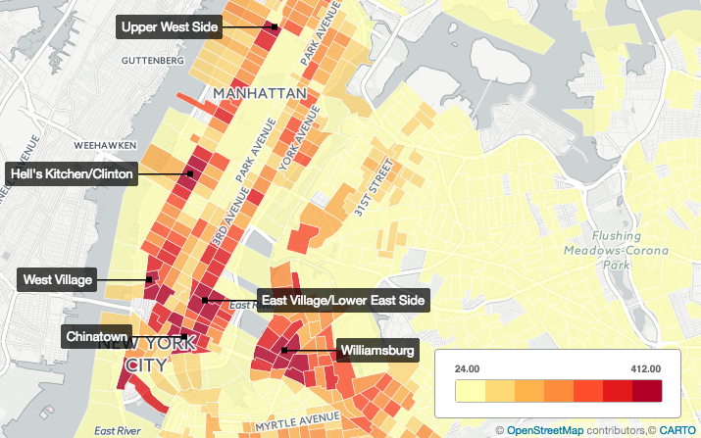
Listings on Airbnb
Airbnb listings are clustered around certain neighborhoods

Slide 6
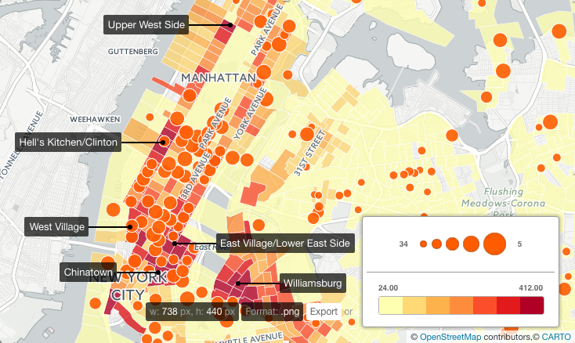
Airbnb offers excess returns over traditional long term rentals
In very desirable areas of Brooklyn/Manhattan, one would need to rent an apartment for only 5 days to make equivalent monthly rent!

Slide 7
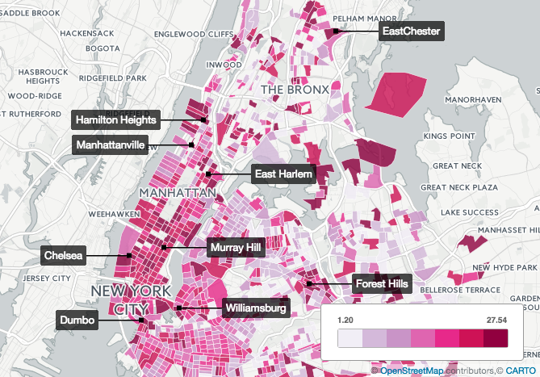
Equivalent Airbnb rates vs. median 12 month rental rates
There are significant return variations across geographical regions

Slide 8
Real Estate 101 Location, Location, Location
The desirability of a neighborhood
The proximity to schools, businesses and services
Ease of commute and access to public transportation
Low crime rates
The value of nearby properties

Slide 9
Can we parameterize these location features from the perspective of a short term renter?
The desirability of a neighborhood
Demographics, % of educated, poverty %, income
Housing affordability
Negative externalities, i.e. # of noise complaints
The proximity to schools, businesses and services
The Hip factor: # of nearby bars, coffee shops from Yelp
Ease of commute and access to public transportation
Taxi and Uber pick-up frequency
Average travel time to work
Low crime rates
The value of nearby properties
Median home values for single family
% of vacant and owner-occupied homes
Momentum indicators: recent sales/rental trends, turnover ratios from Zillow, changes in demographics

Slide 10
Can we predict which neighborhoods offer the best return potential?

Slide 11
Airbnb Rating: Methodology
Hold out 30% of data for testing
MAR = Mean Equivalent Monthly AirBnB Rent
HC = adjustment factor for vacancy
MHV = Median Housing Value
AirBnB Rating = (MAR * 12) * (1 – HC) / MHV
Rating ‘A’ = > 10% expected yield
Rating ‘B’ = 6-10% expected yield
Rating ‘C’ = < 6% expected yield

Slide 12
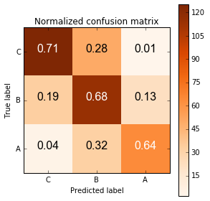
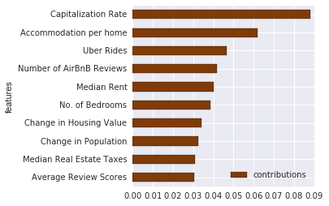
Insights into model predictions
The current model of AirBnB Ratings is 70% accurate
Rating ‘A’ has a precision > 70%, and the false positives fall mostly in rating ‘B’

Slide 13
What are the primary drivers for the the paradigm shift?
Airbnb rental income is correlated with an increase of Uber traffic and apartments that can accommodate excess tenants over the number of bedrooms advertised
Prospective investors need to balance excess returns offered by Airbnb with the difficulty of renting the entirety of a month
Washington Heights, East Harlem, Forrest Hills, Williamsburg and Murray Hills offer compelling values for landlords that intend to leverage the Airbnb platform

Slide 14
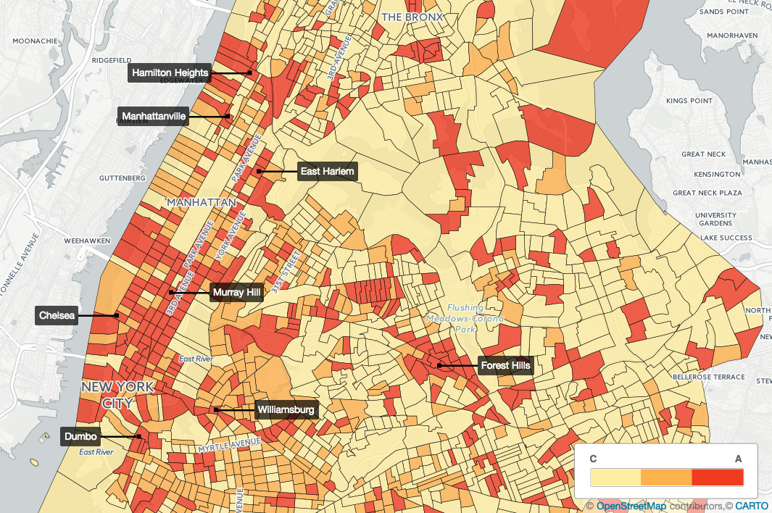
Model predictions at a glance

Slide 15
Interested in taking a deeper dive?
Here is a tool, hosted on my AWS server, that you can try out right now:
Interactive NYC Map
http://52.55.95.182:8888/
It is intended for prospective homebuyers, real estate investors and property managers
The map contains 8 layers and can be overlaid on top of each other
Demographics and pertinent real estate information are displayed on mouse-over
It should work for both desktop and mobile browser. Full functionality is reserved for desktop version only

Slide 16
Contact Info
Ed Chin
Email: echin6@gmail.com
Linkedin:
https://www.linkedin.com/in/edwin-chin-62392b1
Blog: echin6.github.io
Repo: echin6/metis_projects

